Slide 1
TAK Server SDK Setup
https://tak.gov/products/tak-server
https://git.tak.gov/sdks/takserver/tak-server-sdk

Slide 2
TAK Server SDK Setup - Pre-requirements
Install and setup your IDEA for java
Preferred one: JetBrains IntelliJ IDE
https://www.jetbrains.com/idea/
Clone the SDK repository or open the repository for the SDK
https://git.tak.gov/sdks/takserver/tak-server-sdk
If you want all the sample plugins loaded from the downloaded SDK open the zip file and import the .jar file to the /opt/tak/lib location in the TAK Server

Slide 3
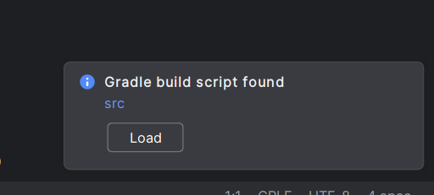
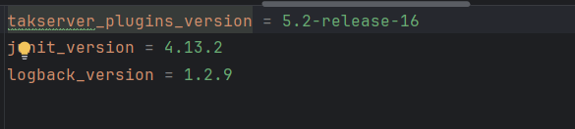
TAK Server SDK Setup - Credentials
Add your credentials for tak.gov
With the IDE open, you should be prompted to load the Gradle build script
Select load
You should now see errors regarding credentials
To add your credentials:
Open the src directory and scroll down to find the gradle.properties and open the file.
The contents should be similar to the following.

Slide 4
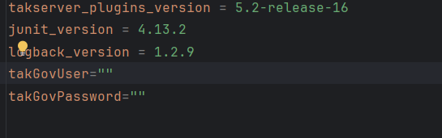
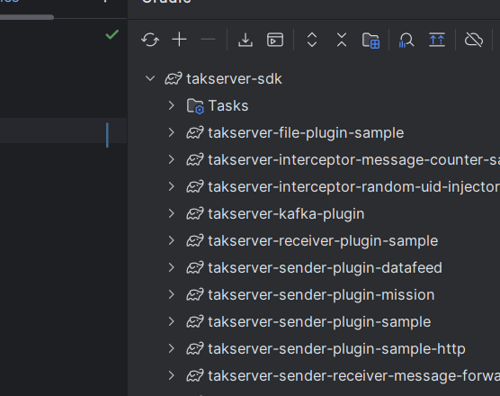
TAK Server SDK Setup - Credentials
Add the following on a new line:
Fill in the fields for username and password.
Reload Gradle

Slide 5
TAK Server - Offline Version
Download the SDK for TAK Server
https://tak.gov/products/tak-server

